Slide 1
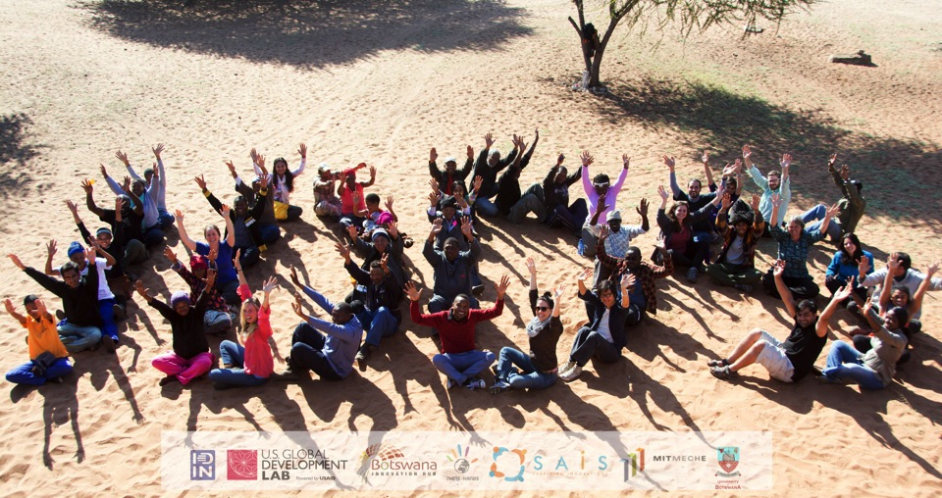
IDDS D’kar
Botswana
August 2 – 16, 2015
2 weeks, 35participants, 6 prototypes

Slide 2
Who are the participants?

Slide 3
Average Age: 37 Youngest: 21 Oldest: 60
Who are the participants?
What did they do?
What will they do next?

Slide 4
Who are the participants?
What did they do?
What will they do next?

Slide 5
What are their goals?
Who are the participants?
What did they do?
What will they do next?

Slide 6
Short Term Goals
"To actually do something constructive is not easy - I look forward to experience a well designed program that might have figured out how to do this… I wish to experience something outside of my comfort zone, to challenge myself, and see my own potential in these situations."
“I am very excited to work with people from around the world. There is always so much to be learned from people with different backgrounds. It is fascinating to see all the different ways people think and like to solve problems.”
“To interact with the communities and assist/contribute to finding lasting solutions to challenges that they may be facing; to be a part of a team that will help individuals and communities grow themselves through improved livelihoods using affordable innovations and technologies as a tool.”
“To push my boundaries and work with an extremely diverse group of people to come up with a design solution which can act as a foundation for a good product.”
“I have worked with indigenous groups in Australia and the USA and as a Motswana I want to become more involved with the San as an ally and as a community development agent.”
“I want to develop myself to improve my project that I have at my village.”
Who are the participants?
What did they do?
What will they do next?

Slide 7
What are their goals?
Who are the participants?
What did they do?
What will they do next?

Slide 8
Long Term Goals
“I'm trying to figure out how collaborative technology design work (international/multicultural/needs-driven) will fit into my future work. I hope to have a sense of how I will either find or make work opportunities within a year or two, and be making steps in that direction.”
San community member: “To learn IDDS and to be able to use effectively to solve local grassroots challenges around subsistence.”
“Looking forward to facilitate the chapter members in Tanzania to perform better and achieving their expectations of designing project with business models.”
San community member: “As an original artist I would like to have improved knowledge on design strategies and handiwork.”
“I hope to make a start in consulting in sustainable living, natural building, wild crafting, etc sector. Include an innovation from the summit in my own homestead.”
“I want to switch careers into design and development. I would love to either bring the prototype I am working on at the summit to market or get involved with a different team and help support their venture. I am very open to relocating to Botswana or wherever the team is based.”
“I hope to work in the impact investing world, and want the ideas of cocreation and design that i learn to help me better decipher valuable impact approaches that are worth investing in.”
Who are the participants?
What did they do?
What will they do next?

Slide 9
To me, IDDS D’Kar will be a success if…
we support the community in D'Kar, and learn a lot.
there is love, cooperation and confidence.
I learn something new, I meet kindred spirits, and I have fun doing it.
if I participate fully and able to practice the skills even after the summit.
I develop strong connections, build a viable prototype with my team and leave with a concrete plan for how to make the career switch.
our engagement with the community and each other yields results that will grow all the people that are part of the summit and positively change their lives.
I can build a functioning machine/technology that will help the community and the design can be moved to improvement and scaling.
Who are the participants?
What did they do?
What will they do next?

Slide 10
What did they do?

Slide 11
Favorite Moments
Build-Its
Design challenges Learning from organizers
Participant presentations Jacob’s video
Prototyping/modeling/experimenting Ora Molelo
Meeting and exchanging ideas with other participants
Stargazing Morning circle
Working in teams
Learning design process
Food!
Interacting with local people/gathering information
Who are the participants?
What did they do?
What will they do next?

Slide 12
What did they do?
The Prototypes

Slide 13
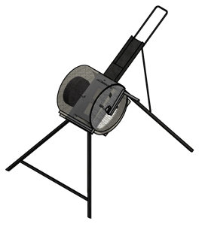
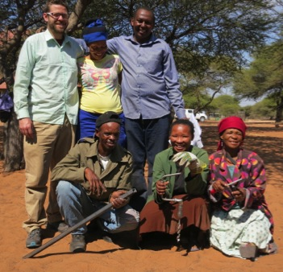
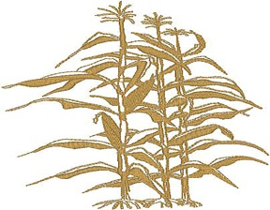
Tcegane Qoane (Fodder Chopper)
TEAM
Aaron Wieler
Jacob Camm
Harold Msdnya
Ncgbe Taase
Tsikina Cukuri
X’loba Segarese
Design Faciliator:
Alex Moseson
Problem Statement
Across Botswana, cattle are dying in winter because of starvation. Crop waste (like stalks) is available but not used because cattle cannot eat uncut stalks. We will work to develop a fodder chopper that is appropriate for use in D’Kar.
=
Key Features
Strong
Safe
Affordable
Income generating
Efficient
Locally made
Product Description
Our fodder chopper was developed with a diverse team and additional input from D’Kar residents. The prototype is made of welded metal, strong enough to chop several stalks at a time, with one person using it. Stalks are laid in a tray, and come out on a large sheet for collection. Power is provided by hand, but an electric motor option will be available. With a target price is 1,500 Pula, it is affordable as a small business or shared device.

Slide 14
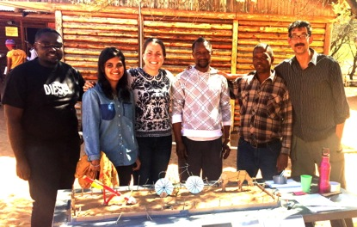
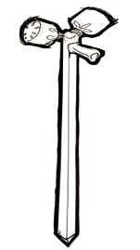

Xh’ara hii ba (Precision Planter)
TEAM
Joseph Dii Mathambo Ngakaeaja
Tamanna Urmi Krista Nordin
Jamie Noon
Design Facilitator: Sunday Silungwe
Problem Statement
The current process for ploughing is labor intensive and not environmentally sustainable, and the current plough is no longer subsidized. There is a movement towards conservation farming (precision planting) in order to efficiently use resources and protect the health of the soil. We will develop a precision planter that is affordable, less labor intensive and promotes conservation farming.
Key Features
Affordable
Lightweight
Single-person operated
Environment friendly
Manufactured locally
Easily repairable
Ergonomic
Durable
Product Description
The Precision Planter consists of a handle, hoppers, vertical pipe, and a hatch/tip at the end.
The user walks while jabbing the planter into the soil with each step, dispensing seed and fertilizer at the appropriate depth. With each jab, the appropriate quantity of seed and fertilizer is released into the soil.

Slide 15
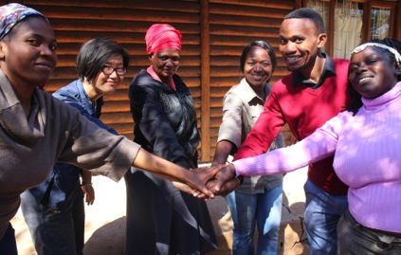
Dao Ba Qaa (Crop Protection)
TEAM
Claudine Chen Merapelo Kesegofetse
Kenewang Moletle Stephen Molatlhegi
Lulu Chuulu
Design Facilitator: Noela Byabachwezi
Problem Statement
Cultivation has only recently been introduced to the people of D’Kar. It is a practice that is not culturally imbedded into their past livelihood of hunting and gathering. Therefore, cultivation has proven to be a challenge to the people of D’Kar. One of the challenges faced by farmers is weed infestation in their fields. Currently, weeding is done by hand, as hoes are said to be too expensive. We will develop an affordable tool that will make the task of weeding easier.
Product Description
Stirrup Hoe - Low cost, light-weight hoe with a handle that can be adjusted according the user’s height and need. It is commercially manufactured, yet not available on the local market. The one we have produced uses locally available materials.
Weed Roller – Allows the user to use it while in an upright position. It can roll over a large area of weeds with a single roll, thereby reducing the time spent as compared with other alternatives. It is a drum-like object with spikes that lift up the weeds as it is rolled over them. Very effective in row-planted fields.
Key Features
Affordable
Durable
Single person operation
Easy to use
Light-weight
Easy to maintain & repair
Materials are locally sourced

Slide 16
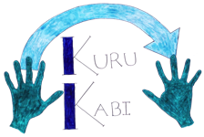
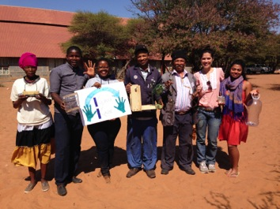
Kuru Kabi (Plastic Waste)
TEAM
Aline Horta Guinle Sidiki Aminata Diakite
Monkgogi Otlhogile Tabaxae Kaashe
Nicodemus Barkard Xhigae Qomaxa
Design Facilitator: Amy Smith
Problem Statement
Plastic beverage bottles are a common waste product in D’Kar. They have secondary uses, such as water storage but we believe by creating and providing the people of D’Kar with a technique for transforming plastic bottles into strips for weaving, they will have the ability to create a variety of products of value for their homes, families and community. Potential uses of this woven material include making household items and products for sale.
Photos of Team and project here
Key Product Components
Kuri Kabi Plastic Cutter: a portable and affordable machine that cuts strips from waste plastic bottles
Kuri Kabi Storage: multipurpose storage containers made from woven plastic strip
Kuri Kabi Instructional Manual: a guide on various products that can be made out of available trash
Product Description
We created a machine that generates plastic strips from waste plastic bottles. These strips are the main component of our weaving method. Our intention is to use this method to create multipurpose containers, as the D’Kar community expressed a need for such products. Examples of products they are interested in include: laundry hampers, food containers, wardrobe organizers, dish racks and gift boxes.

Slide 17
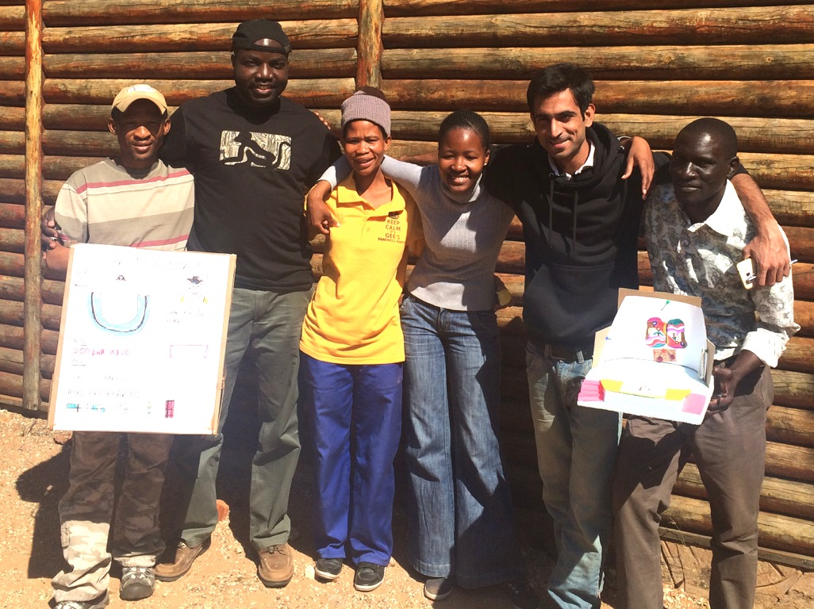
XGOE (Cultural Preservation through ICT)
TEAM
Komtsha Sixpence Muhammad Awais Qasim
Mark Wamai Rachel Kapeko
Mathata (Tizo) Kashongo Xose Tshabue
Design Facilitator: Mustafa Naseem
Problem Statement
Arts and Crafts are an important part of sharing and preserving the San Culture as well as income generation. However a saturated market leading to low sales is a threat to this sector’s existence. We are creating an ICT-based solution that provides access to a wider market for San Arts and Crafts, leading to higher income and therefore providing incentives for preserving the aspect of culture.
Key Features
Artist Profiles
Product Uploading
Product Catalog
Online Payments
Social Media Integration
Mobile App
Product Description
Our platform is an online marketplace for San Arts and Crafts. Imagine a place where you can find handmade crafts, jewelry, paintings and clothing made out of ostrich egg shells, glass beads as well as a range of other natural materials by San craftsmen and women. Our ICT-based solution can facilitate hundreds of San Artists in the Kalahari area to make their Arts and Crafts available through online stores such as Etsy as well as receive payments locally.

Slide 18
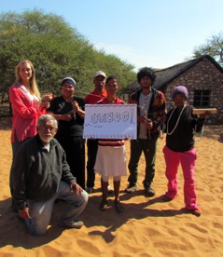

HaaBoo! (Ostrich eggshell beads)
TEAM
Anirudh Ganapathy
Maria Morris Qasa Tsixbo
Natalie Markham Qguba Tshabue
Design Facilitator: Suprio Das
Problem Statement
For generations, making jewelry from ostrich eggshells has been an important income generation activity for San women. Making beads and jewelry from ostrich eggshells is a long and tedious process. In addition to being labour intensive, the process causes the worker hand, leg and especially back pain. Finally, many beads are broken throughout the production steps. Through both process and tool innovation, we will reduce the burden and increase the efficiency of making ostrich shell jewelry.
Product Description
The ostrich bead making process has been shortened primarily through the use of a manual hand drill. The drill allows a 120% improvement in the time it takes to drill the bead’s center hole. Using the drill with a hook fixed as a bit allows faster twisting of the plastic used to make twine for bead stringing and eliminates the skin burn caused by the previous twisting method. We are further exploring the creation of a device that will allow simultaneous sanding of multiple strings of beads and a drill bit that would cut both the the bead’s circular shape and center hole in one step.
Key Features
Increase efficiency and productivity
Ergonomics
Using locally available resources

Slide 19
The Value of IDDS
Who are the participants?
What did they do?
What will they do next?

Slide 20
The Value of IDDS
“The IDDS has been a fundamental opportunity for me to learn to be more of a problem solver, not just someone who would talk and enjoy discussing or describing the problem. It has been a good opportunity to further learn to work with other people to achieve common goals.” - Stephen
“Meeting interesting people and connecting with them. Connecting in the sense of actually connecting and not networking.” - Anirudh
“IDDS is valuable more in the growth of participants than in the likelihood of continuity of projects. In my case, gaining confidence and excitement around tool usage was most valuable.” - Natalie
“IDDS teaches an important process, of true community driven design. I believe that only this approach will lead to sustainable improvements in the target communities. The formal training and on the ground practice has been an effective teaching method and I believe I have learned a lot, enough to apply IDDS principles to my own work.” - Claudine
“The most value of IDDS is some experience that I have for example welding, cutting metal equipment with a machine because first I didn’t know how to weld or cut metal with a machine.”
-Tsikina
Who are the participants?
What did they do?
What will they do next?

Slide 21
New Skills
Who are the participants?
What did they do?
What will they do next?

Slide 22
New Skills
“The hands on experience of learning was the better outcome of the past two weeks. The balance between classroom activities and workshops was really good. Been able to practice what was taught during the morning, involved in a real project with real people made the learning experience even better.”
“I have learned quite a lot, but most surprising is the use of pet bottle to make household items.” - Nico
“The ability to use the design cycle to systematically develop lasting solutions to everyday challenges.”
“I had made a foam cutter out of two batteries and some wire, so I will be able to cut even plastic.” - Tabaxae
Who are the participants?
What did they do?
What will they do next?

Slide 23
Change in Attitudes
Who are the participants?
What did they do?
What will they do next?

Slide 24
Have you changed?
“I feel more certain that my inclinations must be listened to, that there is possibly a career for me. The design process taught at IDDS validates me to myself.” - Claudine
“Yes, because through group work activities, morning circle, lunch talks have changed me a lot to think about the outside world.” - Tizo
“Quite a lot because I now know that I can make use of the material around me, which I previously thought useless.” - Nico
“Yes. I’m not one to be very keen on repetitive steps, but the design process helped me to appreciate the value of iteration.” - Mark
“Yes, I learned to think and approach everything from a design point of view and take advantage of available needs in our communities to improve the wellbeing of people.” - Rachel
Who are the participants?
What did they do?
What will they do next?

Slide 25
Self Assessment
The participants evaluated their own skills in the beginning and in the end.
After the summit….
Over 50% of participants said they feel more confident:
  using found or discarded materials to make something new
Over 40% of participants said they feel more confident:
  making something that they have envisioned in their head
  staying focused on their aims and accomplishing their goals
Who are the participants?
What did they do?
What will they do next?

Slide 26
What will they do next?

Slide 27
After IDDS
Who are the participants?
What did they do?
What will they do next?

Slide 28
After IDDS
63% of respondents said that they want to continue actively working on their projects
36% said they would stay in touch to check up on progress, but not work on it actively
Who are the participants?
What did they do?
What will they do next?

Slide 29
Interest in Volunteering with IDIN
Who are the participants?
What did they do?
What will they do next?

Slide 30
Anything else?
“IDDS should keep coming to teach us more skills.”
“Fun, frustrating, worth it.”
“I would like to thank everyone that was involved in making this summit ready. I had a blast of a time here and I am going home with my heart filled of joy, excited about the new opportunities that the future holds, now that I am part of the IDIN family!”
Who are the participants?
What did they do?
What will they do next?

Slide 31
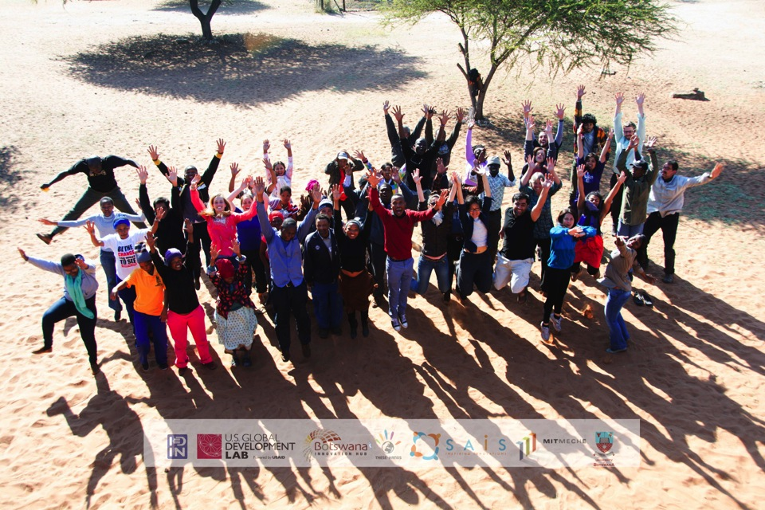
Thank you!
Learn more at www.idin.org

